Slide 1
SRM-NIRS-EEG Update
02/09/2024

Slide 2
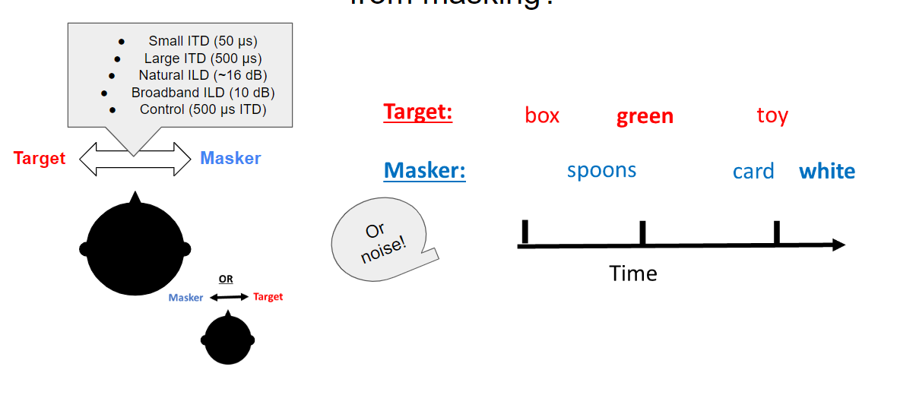
Task Reminder

Slide 3
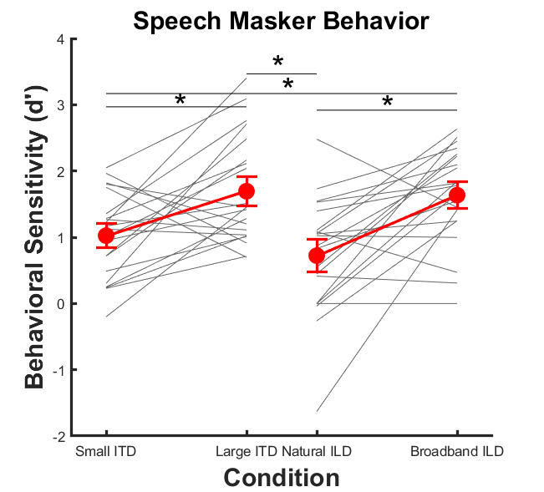
Current Behavior Results (n=20)

Slide 4
Splitting results into speech and noise masker
If we only observe behavioral differences with a speech masker, I hypothesize that we will see activation differences only with a speech masker

Slide 5
Block averages speech masker

Slide 6
Betas speech masker

Slide 7
Block averages noise masker

Slide 8
Betas noise masker

Slide 9
Now what about noise masker, where we don’t see change in performance across spatial cues?

Slide 10
Beta values and behavior
Speech Masker
Noise Masker

Slide 11
STG individual block averages
Speech Masker
Noise Masker

Slide 12
PFC individual block averages
Speech Masker
Noise Masker

Slide 13
Noise

Slide 14
Speech

